Slide 1

Credit Card Fraud Detection Using Logistic Regression
An Analysis of Transaction Data
Presented by: Konstantinos Lamprou

Slide 2

Project Introduction
Project Overview:
Objective: Credit Card Fraud Detection using Machine Learning
Dataset: Credit Card Fraud Detection Dataset
Number of Transactions: 284,807
Features: 31 (including 'Time', 'Amount', and 28 anonymized features 'V1'-'V28’)
Target Variable: 'Class’
Class Distribution: Highly imbalanced (99.83% legitimate transactions, 0.17% fraudulent transactions)

Slide 3
Business Context:
Key Points:
Data Preprocessing: Under sampling to balance classes
Model Choice: Logistic Regression for simplicity and interpretability
Outcome Expectation:
High precision and recall to minimize false positives and negatives
Enhance security and trust in financial transactions
Importance: Mitigating financial losses due to fraudulent transactions
Challenges: Handling imbalanced data for effective fraud detection
Approach: Utilizing machine learning to improve detection accuracy

Slide 4
Dataset Overview:
Dataset Source:
Credit Card Fraud Detection
Dataset Number of Records: 284,807 transactions
Number of Features: 31 (including the target variable 'Class’)
Class Distribution: Highly imbalanced (0 - Legitimate: 99.83%, 1 - Fraudulent: 0.17%)

Slide 5
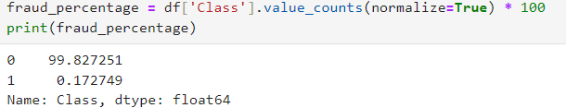

Data Preprocessing
Checking for Missing Values
Calculate the percentage of fraud and non fraud transactions
Separate the Data

Slide 6
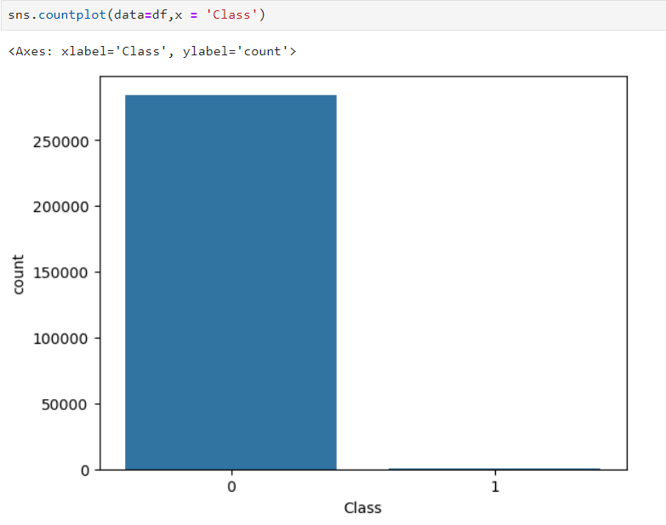
Exploratory Data Analysis
Class Distribution Before Under sampling:
Bar chart showing the imbalance between legitimate and fraudulent transactions

Slide 7

Under Sampling
-Why did we choose under-sampling to address class imbalance?
Address Imbalance: The dataset had a significant class imbalance with fraudulent transactions being a minority (0.17%) compared to non-fraudulent ones (99.83%).
Enhance Model Performance: Under-sampling helps balance the class distribution by reducing the number of majority class instances (non-fraudulent transactions), making it easier for the model to learn patterns from both classes.
Mitigate Bias: By under-sampling, we reduce the bias towards the majority class, which can lead to more accurate predictions for the minority class (fraudulent transactions).

Slide 8
Choosing the Model – Logistic Regression
Logistic regression is a widely used machine learning algorithm, particularly effective for binary classification tasks such as fraud detection. Here are the main reasons for choosing logistic regression in this context:
Simplicity and Effectiveness: Logistic regression provides a straightforward and effective solution for separating two classes, such as identifying fraudulent transactions.
Interpretability: Predictions from logistic regression are easily interpretable as probabilities, allowing for clear understanding of how each variable affects the likelihood of classification.
Good Performance on Medium-Sized Datasets: Especially when dealing with medium-sized datasets and moderate class imbalances, logistic regression demonstrates good performance without requiring complex computations.

Slide 9
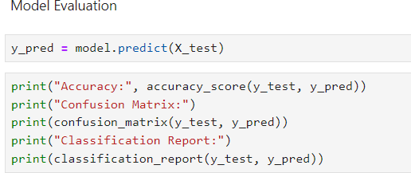
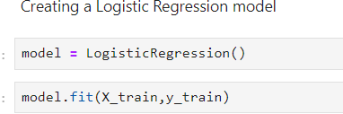
Logistic Regression

Slide 10
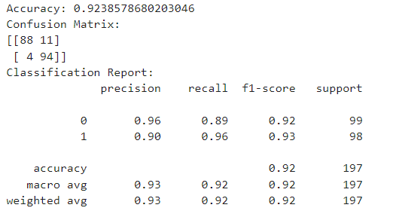
Model Evaluation
Model Performance Metrics
Accuracy: 92.39%
The model correctly identifies fraud and non-fraud cases 92.39% of the time, indicating high overall performance.
Precision:
Class 0 (Non-fraud): 96%
High precision indicates that 96% of transactions labeled as non-fraud are actually non-fraudulent.
Class 1 (Fraud): 90%
90% of transactions labeled as fraud are truly fraudulent
Recall:
Class 0 (Non-fraud): 89%
The model successfully identifies 89% of actual non-fraudulent transactions.
Class 1 (Fraud): 96%
The model captures 96% of all actual fraudulent transactions, minimizing missed fraud cases.

Slide 11
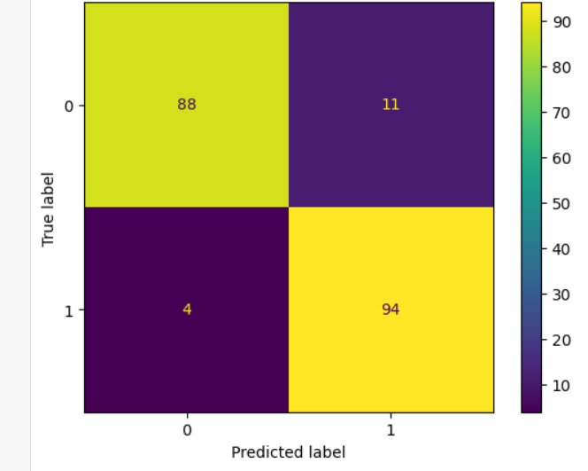
Model Evaluation
Model Performance Metrics
Confusion Matrix Analysis:
True Positives (TP): 94
Correctly identified 94 fraudulent transactions.
True Negatives (TN): 88
Correctly identified 88 non-fraudulent transactions.
False Positives (FP): 11
11 non-fraudulent transactions incorrectly labeled as fraud.
False Negatives (FN): 4
Only 4 fraudulent transactions incorrectly labeled as non-fraud.

Slide 12
Project Summary:
Successfully developed a logistic regression model for credit card fraud detection.
Achieved high accuracy (92.39%) in identifying fraudulent transactions.
Effectively balanced dataset using under sampling to handle class imbalance.

